Slide 1
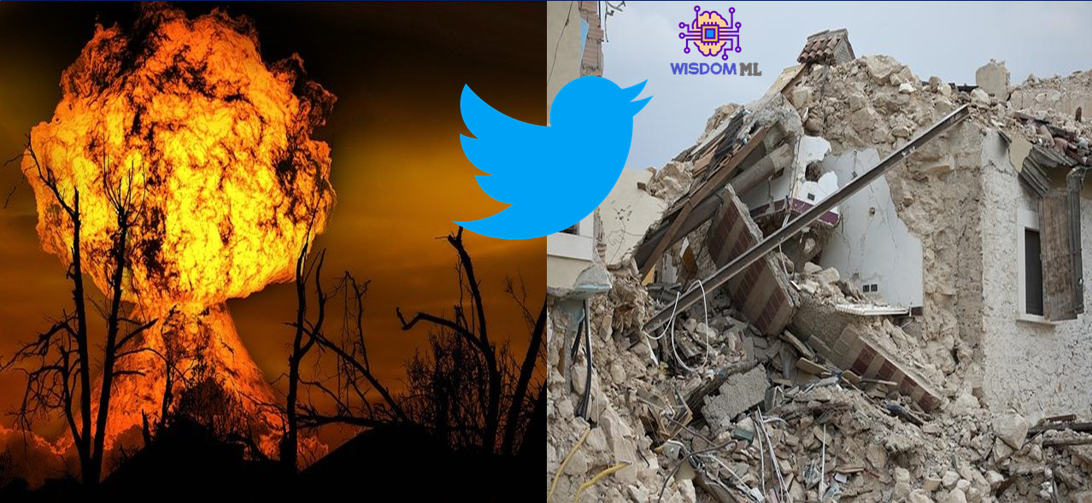
Disaster Tweet Classification
Debasis Panda
Batch-VI
GithubLink-https://github.com/Deb052024/Text-Analytics

Slide 2
Case Flow of Presentation
Data Loading and Exploration : Data Set Loading and Tokenize text into words
Data Preparation : Cleaning text by removing Special characters, URLS and punctuations, Null Value Treatment
Feature Engineering and Model Selection : Word Frequencies, Vader sentiment analysis, Pre trained Word Embedding
Length Count and Word Cloud : Tweet Length , Has Tag Presence and User Mention
Model Selection and Training: Logistic, Naïve Bayers, Cross Validations, Linear SVC, Random Forest, Neural Network
Model Evaluation and Comparison : Precision, Recall, Accuracy, F1 score, Confusion Matrix, AUC, ROC
Saving the Model : Pickle File generation for Models and TFIDF
Deployment and User Friendly Interface Design in Streamlit with clear segregation on the Predictions

Slide 3
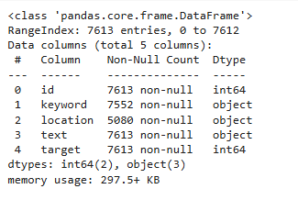
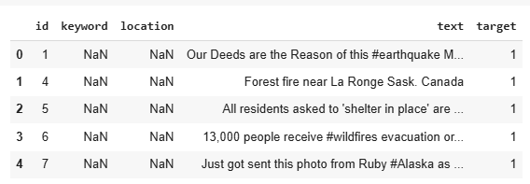
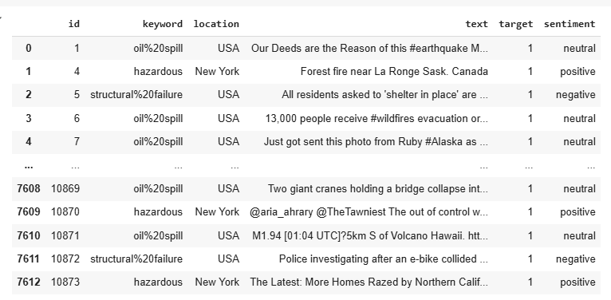
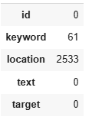
Data Frame Treatment and Preparation
Fig-1
Fig-2
Fig-3
Data Frame has two integer type and three object type feature
Special characters , null values presence in features like “Keyword”, ”Location” and “ Text”
Null values have been replaced based on most common keyword associated with the rows sentiment
Interpretation
TextBlob to Classify the sentiments as positive, negative, or neutral based on polarity
Group by sentiment and get the most frequent keyword and location for each sentiment
Feature wise Null value in Data Frame pre Treatment

Slide 4
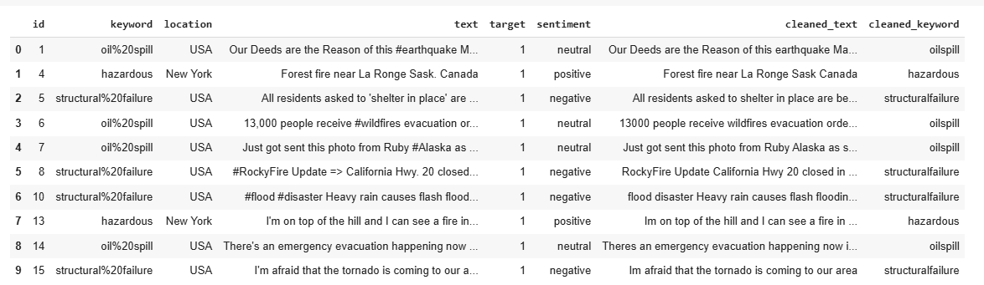
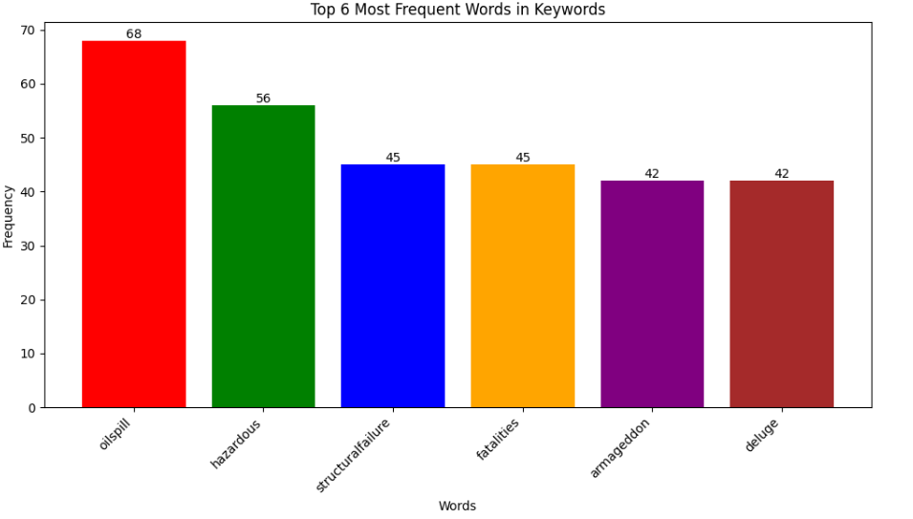
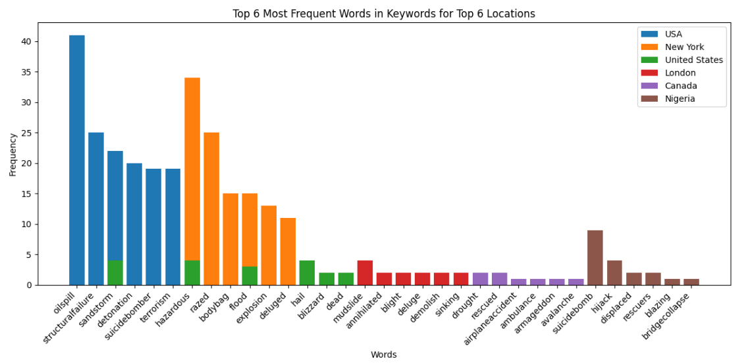
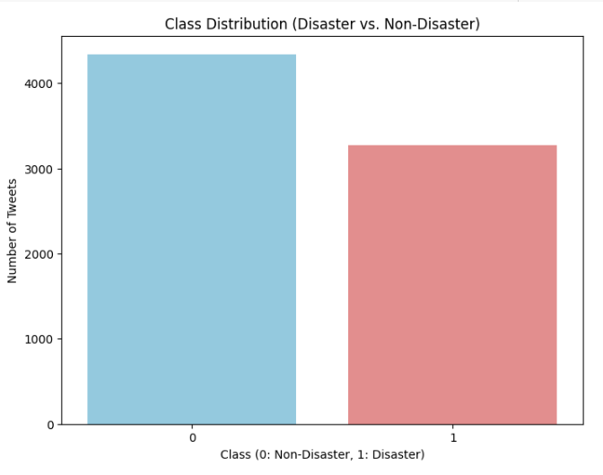
Data Preparation, Feature Engineering and Visualization
Top three most frequent used keywords were oil spill, hazardous and structural failure
Url, special characters, Extra white Space were removed using split method
Separate column cleaned_text and cleaned_keyword were created for the dataframe
Bar Plot reflects more tweets on Non-Disaster based on target feature
Location wise top three most frequent used keywords are for USA, New York and United States with keywords “oilspill”,”structural failure” and “sandstorm”

Slide 5
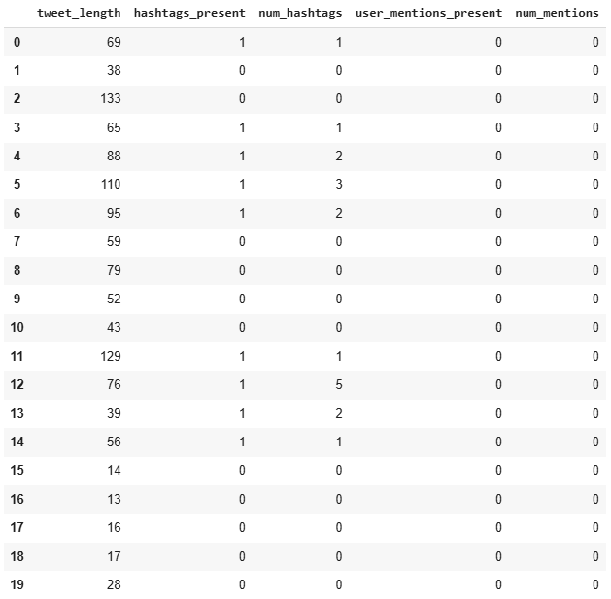
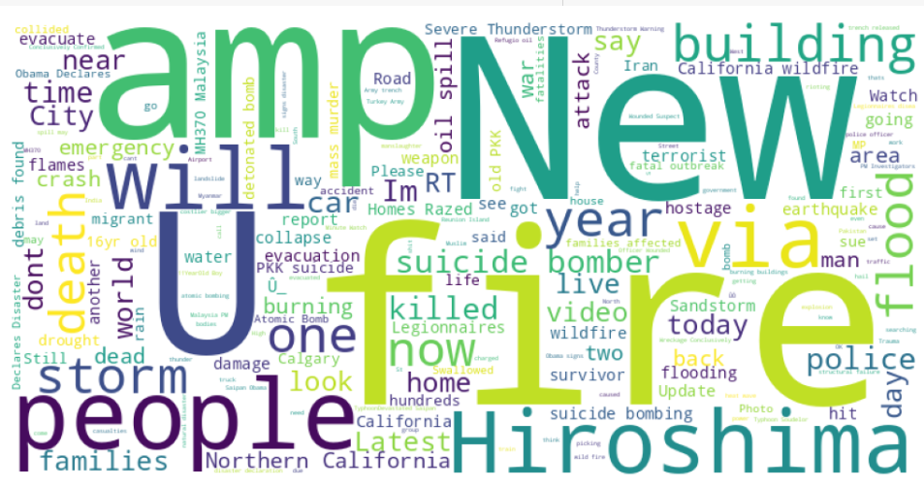
Feature Extraction and Length Count
Word Cloud
Interpretation:
Text feature of the data frame has been split into tweet_length, hashtag_presence, num_hastags, user_mention, num_mentions fields
Tweet length were calculated, presence of hastag, user_mention have been shown as 1 and non presence as 0
Num_hastags and num_mentions have been calculated
Interpretation:
Post Tokenization , lemmatization have been applied on the clean_text feature
Word Cloud has been formed on the disaster related tweet
Fire, people, Hiroshima ,amp were few of the words come up from the word cloud

Slide 6
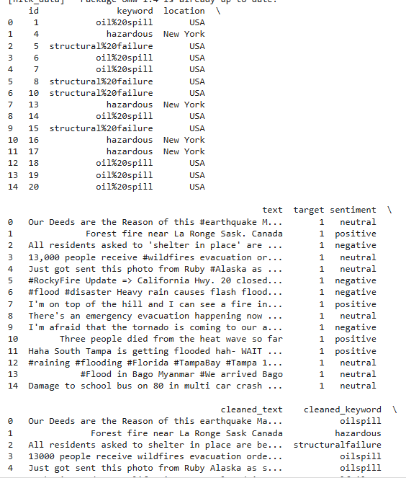
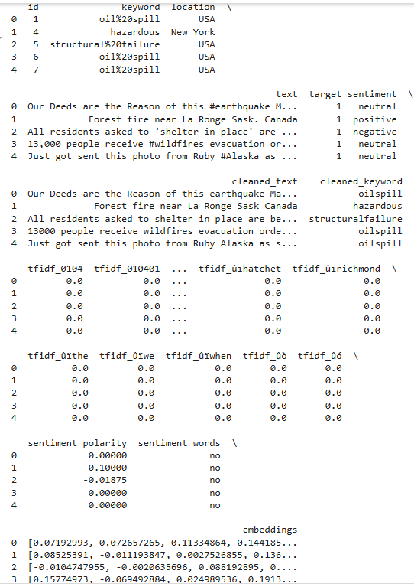
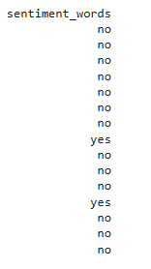
Leverage pre-trained word embeddings (e.g., Word2Vec, GloVe) for semantic meaning
Lemmatization and Sentiment Analysis
Interpretation:
Pre trained word embedding has been imported(genism-word2vec)
Tokenization has been applied on text feature and avg embeddings was found
Custom built function get_embedding has been applied on cleaned_text
For each row under embeddings , numerical vectors capture the semantic meaning of words, allowing words with similar meanings to have similar vector representations, have been shown
Interpretation:
On the Lemmatized Text , sentiment analysis has been applied
Based on the sentiment Score, sentiment has been classified into disaster or non-disaster based on a threshold
For disaster-related tweets (target == 1): The code performs sentiment analysis on the 'cleaned_text' using the get_sentiment_words function. If the sentiment is positive (likely indicating a disaster), 'sentiment_words' is set to "yes"; otherwise, it's set to "no."
For non-disaster tweets (target == 0): 'sentiment_words' is directly set to "no."

Slide 7
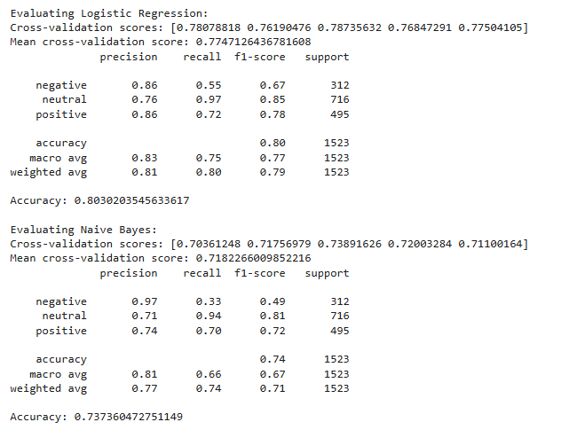
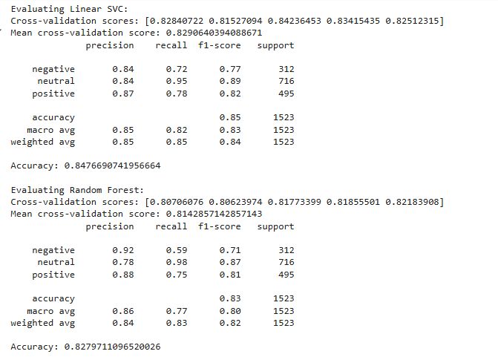
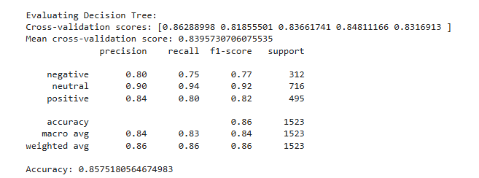
Model Selection and Training
Interpretation:
This DataFrame provides a comparison of all the models above (Logistics, SVC, Decsion Tree, Naïve Bayes, Random Forest) based on chosen metrics (Precision, Recall, F1 score and CV Score)
F1-score and Mean CV Score: The F1-score provides a balance between precision and recall, making it a good overall metric. The mean cross-validation score indicates how well the model generalizes to unseen data.
Choose the model with the highest F1-score and a good Mean CV Score: This will likely be your best-performing model.(Linear SVC and Decion Tree for both disaster and non disaster related tweet)
Consider the trade-off between precision and recall: If one metric is more important for your specific application (e.g., high precision is crucial for minimizing false alarms), you might prioritize a model that performs better on that metric.

Slide 8
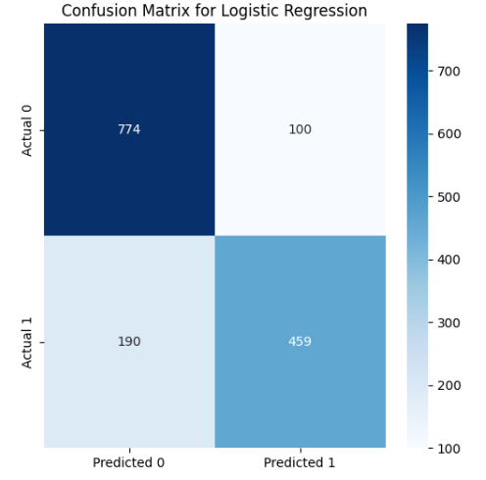
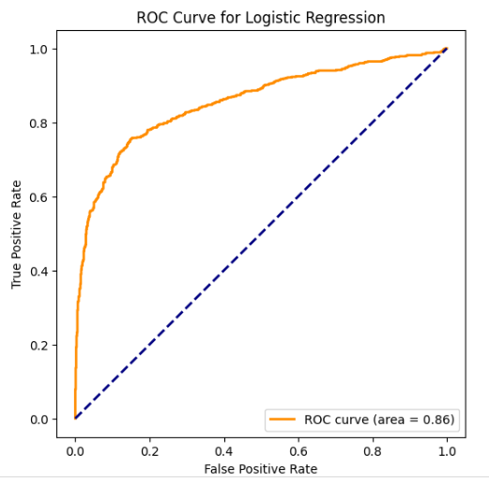
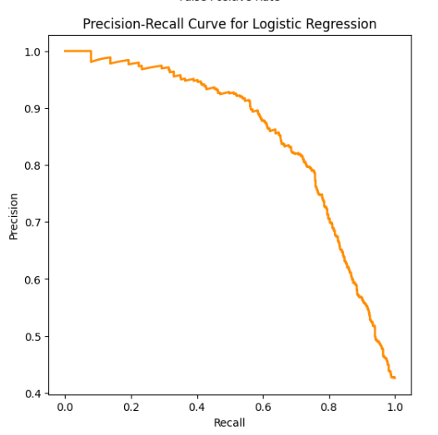
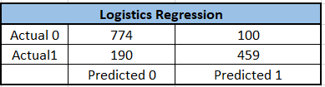

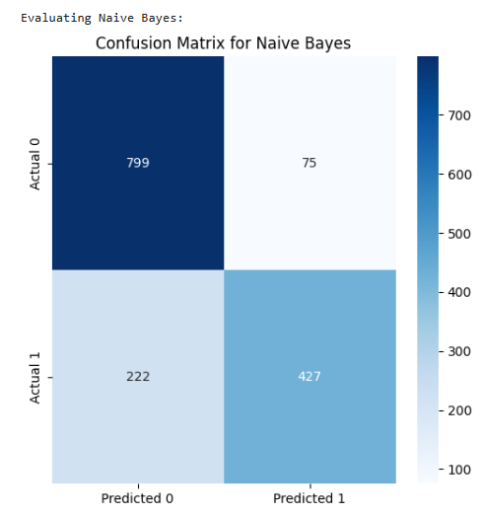
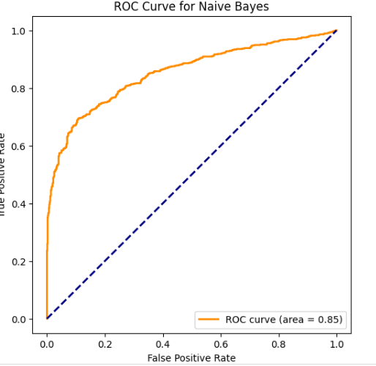
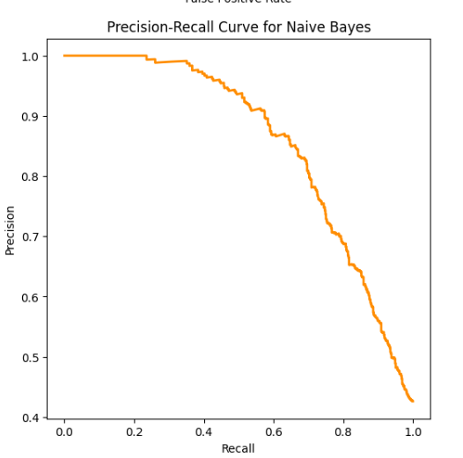
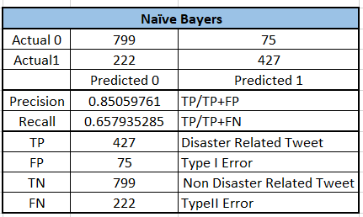
Model Evaluation and Comparison-Part-1
Interpretation
Confusion matrix A table that summarizes the performance of a classification model by showing the counts of true positives (TP), true negatives (TN), false positives (FP), and false negatives (FN).
High precision means the model makes few false positive predictions.
High recall means the model identifies most of the actual positive cases.
There's often a trade-off between precision and recall.

Slide 9
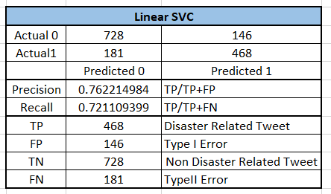
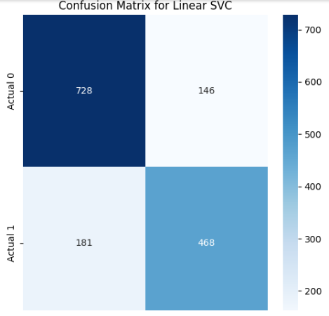
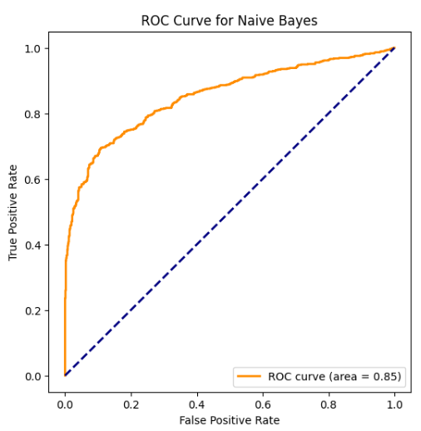
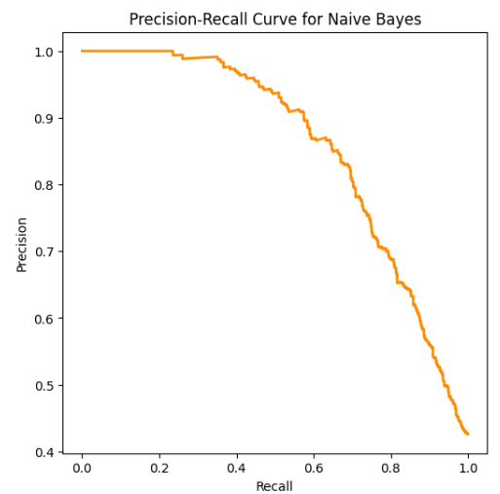
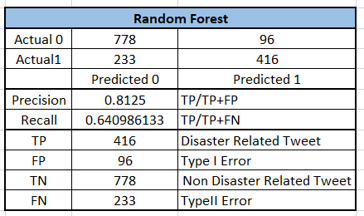
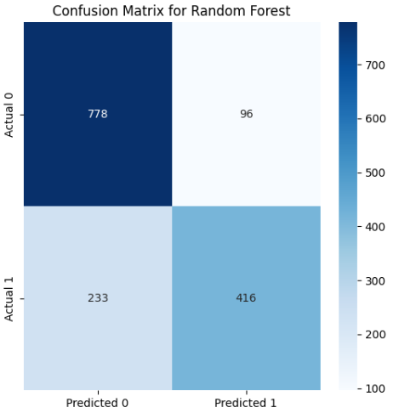
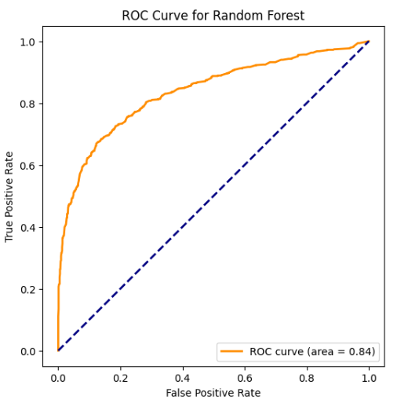
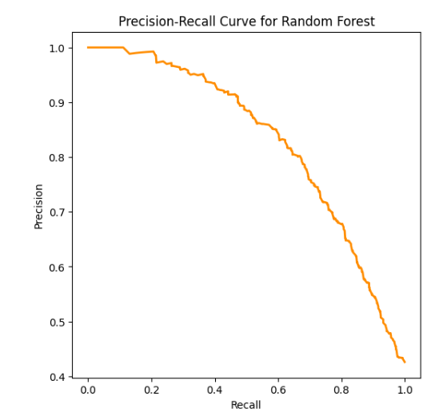
Model Evaluation and Comparison-Part-2
Interpretation:
A plot showing the performance of a classification model at different classification thresholds.
X-axis: False Positive Rate (FPR) = FP / (FP + TN) (1 - Specificity)
Y-axis: True Positive Rate (TPR) = TP / (TP + FN) (Recall/Sensitivity)
A curve closer to the top-left corner indicates better performance (higher TPR, lower FPR).
AUC (Area Under the Curve): A single number summarizing the ROC curve's performance. A higher AUC (closer to 1) is better
Naïve Bayes

Slide 10
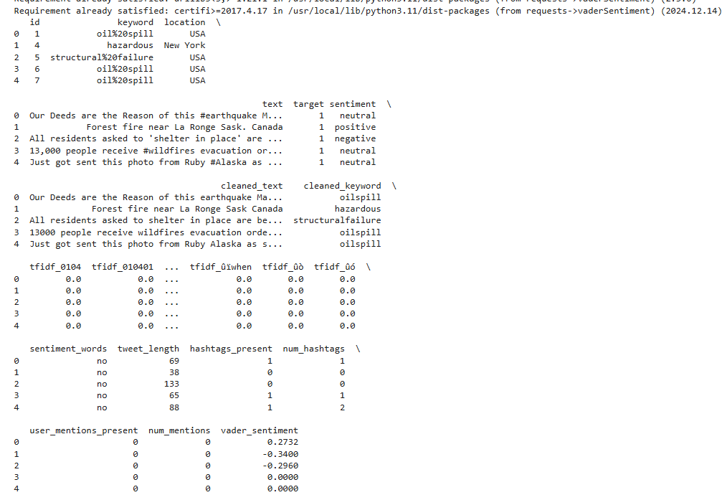
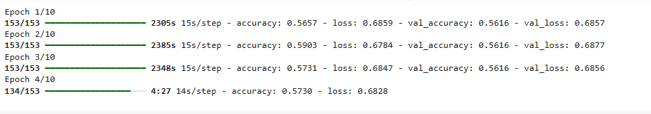

Vader Sentiment Analysis
Model Evaluation and Comparison-3
Interpretation:
RNN network
The model is learning, as training accuracy is increasing and training loss is decreasing from 1st to 2nd EPOCH.
The model is generalizing reasonably well since validation accuracy is also increasing and validation loss is decreasing, and these values are close to the training metrics.
You might want to train for more epochs to see if the model can further improve.
If val_accuracy starts to decrease or val_loss starts to increase while accuracy and loss continue to improve, it would be a sign of overfitting. In that case, you might need to apply regularization techniques or reduce the model's complexity.
More Epochs: You would likely want to train for more epochs to see if the validation metrics continue to improve.
Hyperparameter Tuning: Experiment with different LSTM units, embedding dimensions, batch sizes, and other hyperparameters to find the optimal settings.
Regularization: Add techniques like dropout to prevent overfitting.
Best Fit Model-Serialization-Pickle File Generation
Save trained models: After training model (Logistic Regression, SVC, RNN, NaiveBayers, Random Forest, etc.), we would want to save it using pickle.dump so we can reuse it later without retraining.
Save your TF-IDF vectorizer: The vectorizer used to transform text data into numerical features is also an object that you can save using pickle for later use.
By saving these objects using pickle, we can easily load them back into Colab environment or another Python script, which is essential for model deployment and sharing.
VADER sentiments helps in quickly assessing the sentiment of tweets and classifying them into disaster-related or not.
We can experiment with different thresholds and evaluate its performance to see if it meets your needs.

Slide 11
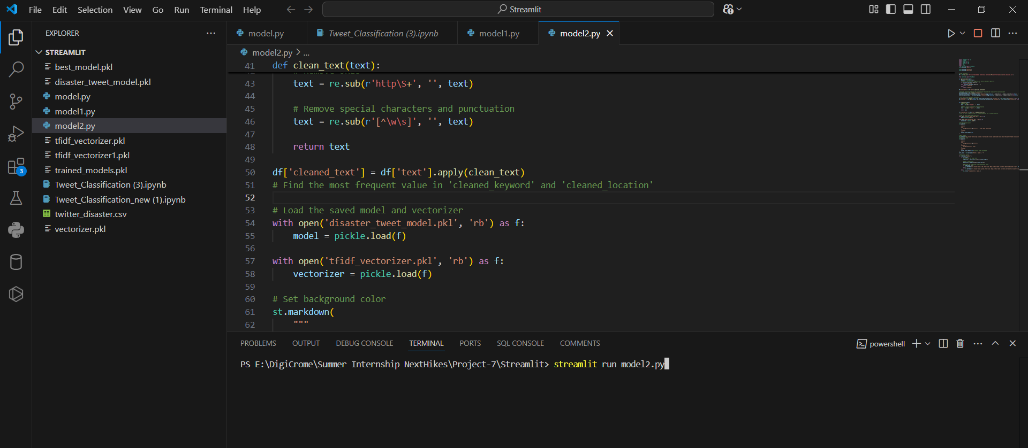
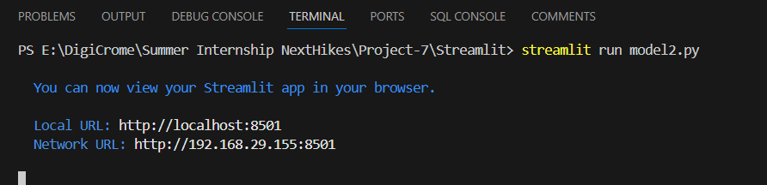
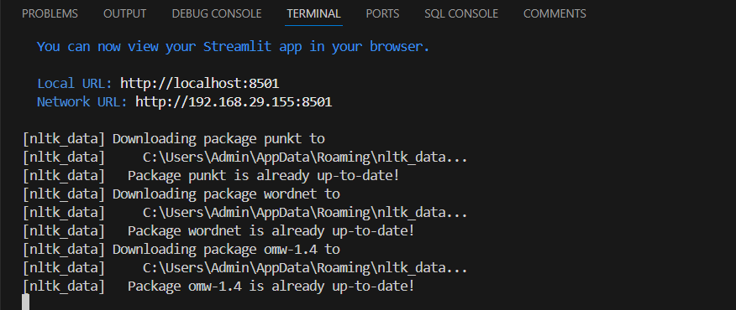
VS CODE –Deployment
Interpretation:
Stored best_model_pkl and tfidf_vectorizer.pkl files have been called in model2.py
Punkt is an unsupervised machine learning-based sentence tokenizer. It's part of the NLTK library and is widely used for splitting text into sentences.
Local Host URL has been called and streamlit app was opened in browser

Slide 12
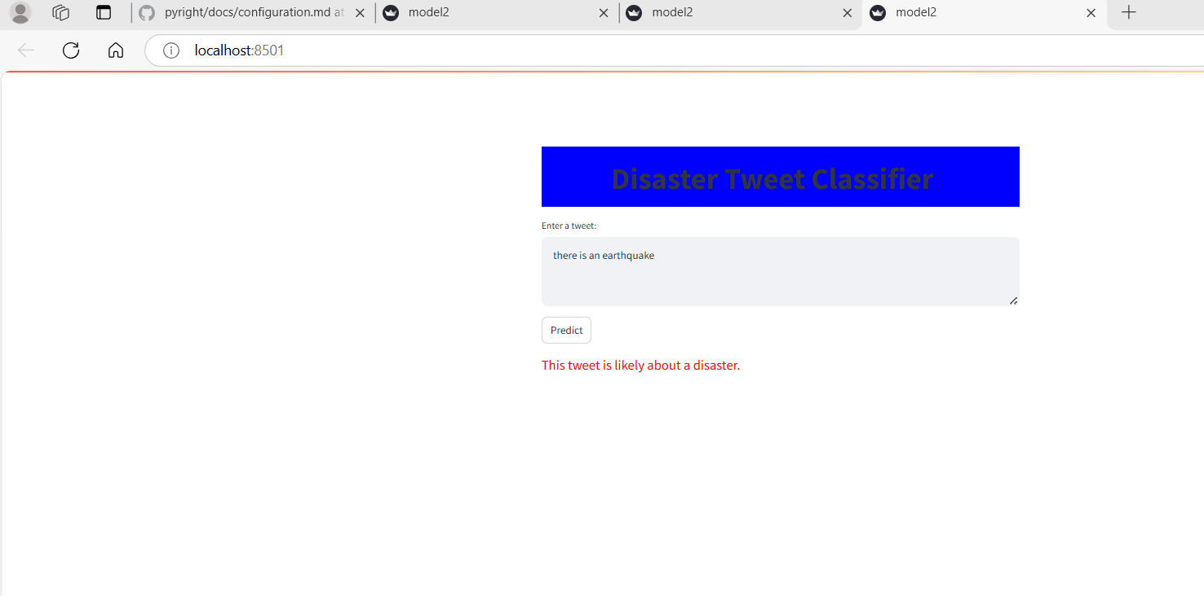
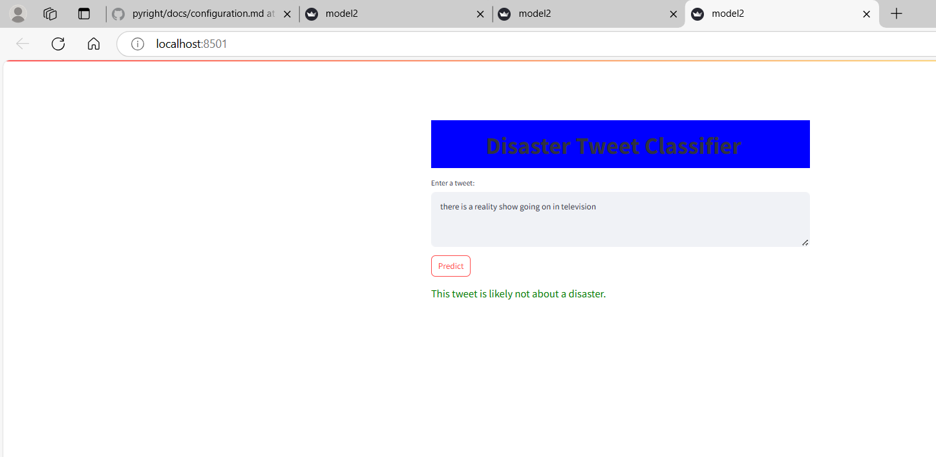
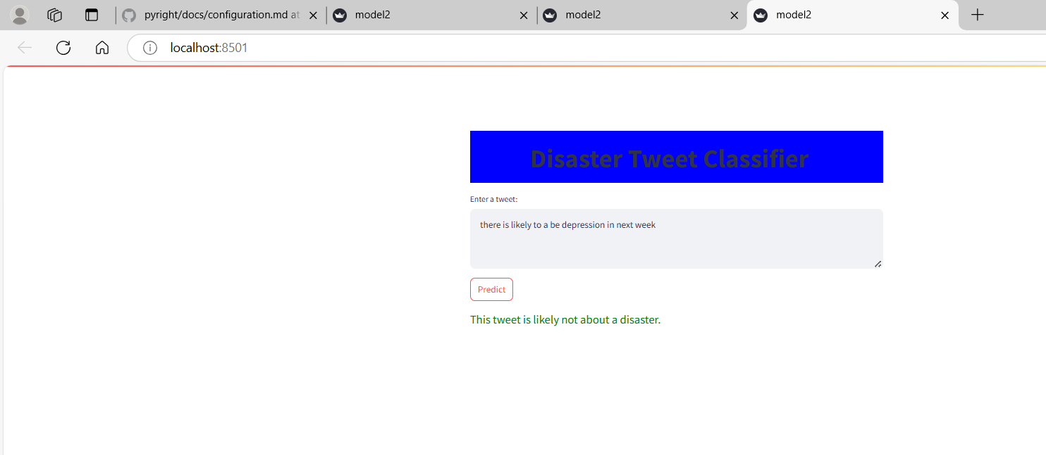
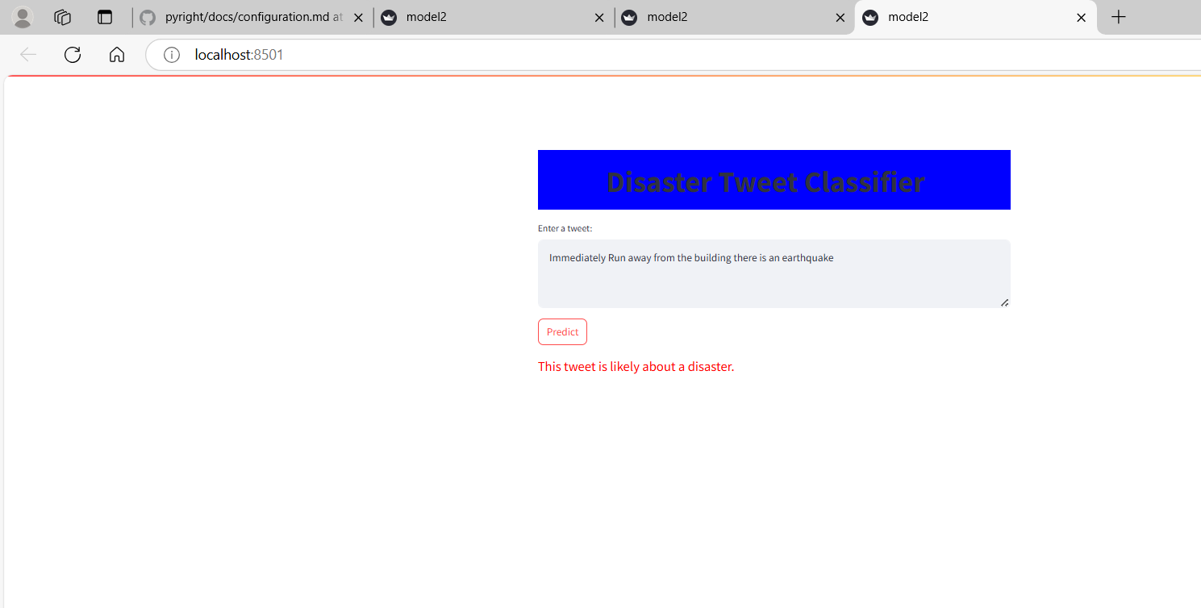
GUI Customization and Prediction -Streamlit-Local Host
Interpretation:
Green color indicates the Prediction as a Non Disaster Related Tweet
Red indicates the prediction for a Disaster related tweet

Slide 13
THANK YOU

